Slide 1
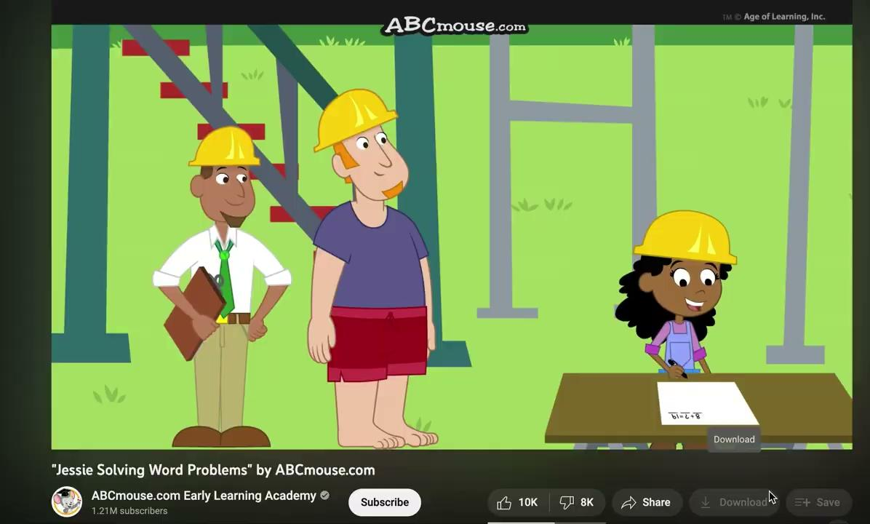
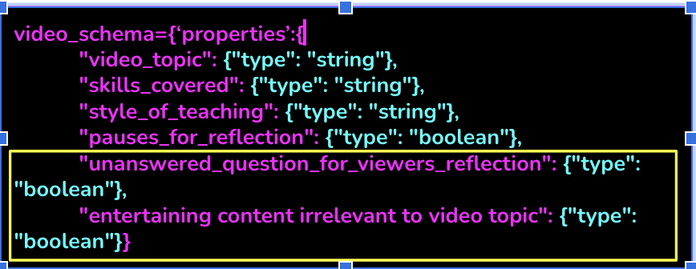
Can we better understand educational video through Large Language Model?
Tasmia Shahriar, Xintian Tu
Mentors: Dr. John Stamper, Christine Kwon
'video_topic': 'solving word problems',
'skills_covered': 'addition, subtraction', 'style_of_teaching': 'using number families', 'pauses_for_reflection': True, 'unanswered_question_for_viewers_reflection': False, 'entertaining content irrelevant to video topic': True
question topic': swim trunks,
'skill covered in question': addition,
'complete question': 'How many beams did the crane deliver?',
'complete question context': "..",
'solution to complete question': 'The crane delivered 11 beams.',
'start time of question': '1:00',
'end time of question': '1:04'
Notes:
Firhose slide

Slide 2
Research questions
How do Large Language Models assist in extracting informative video features to enhance the understanding of content that optimizes learning outcomes?
Notes:
Students use youtube educational videos for their external learning. So we wanted to see if we can leverage the LLMs to extract features of a video so that we can understand how those features interact with learning or provide us some in
We specifically looked at the extraction of three features (1) Complete problem statement or questions demonstrated in the video along with context (2) If the presenter in the video is pausing for viewers reflection often and (3) if there are many off topic entertaining elements in the video that might distract the learners to test if coherence principle persist or not.

Slide 3
Schema iterations
schema={‘properties’:{
"topic": {"type": "string"},
"questions_asked": {"type": "string"},
"skills_covered": {"type": "string"},
"start_time_of_skill": {"type": "string"},
"end_time_of_skill": {"type": "string"}}
video_schema={‘properties’:{
"video_topic": {"type": "string"},
"skills_covered": {"type": "string"},
"style_of_teaching": {"type": "string"},
"pauses_for_reflection": {"type": "boolean"}}
question_schema={‘properties’:{
"question_topic": {"type": "string"},
"question_with_context": {"type": "string"},
"skill_covered_in_question": {"type": "string"},
"start_time_of_question": {"type": "string"},
"end_time_of_question": {"type": "string"}}
video_schema={‘properties’:{
"video_topic": {"type": "string"},
"skills_covered": {"type": "string"},
"style_of_teaching": {"type": "string"},
"pauses_for_reflection": {"type": "boolean"},
"unanswered_question_for_viewers_reflection": {"type": "boolean"},
"entertaining content irrelevant to video topic": {"type": "boolean"}}
question_schema={‘properties’:{
"question_topic": {"type": "string"},
"question_with_context": {"type": "string"},
"solution to complete question": {"type": "string"},
"skill_covered_in_question": {"type": "string"},
"start_time_of_question": {"type": "string"},
"end_time_of_question": {"type": "string"}}

Slide 4
Dataset: 10 videos from Youtube
Topic | Sub-topics | Videos
Math | Geometry Area | 3
Math | Word Problems | 2
Math | Solving two-step equations | 3
Chemistry | Conversion of units | 2

Slide 5
Reliability
We identified the hardest feature extraction would be the extraction of questions or problems that the presenter is solving in the video.
To measure how reliable LLM generated questions from the video were, we manually tagged the “question” “context” and “solutions” properties returned by LLMs as either correct or incorrect.
Based on Cohen’s Kappa coefficient, the inter-coder reliability for this coding showed κ = 0.60.
Notes:
The data suggested that LLMs could identify the start time and end time of a question asked by the presenter in the video, the specific question, the skills related to the question and the solution of the question discussed in the video from the audio transcript alone. the moments where they paused the video for further reflection, the skill covered in the video, and the overall affect content in the video, whether the video has entertaining content or more viewers reflection pausing content

Slide 6
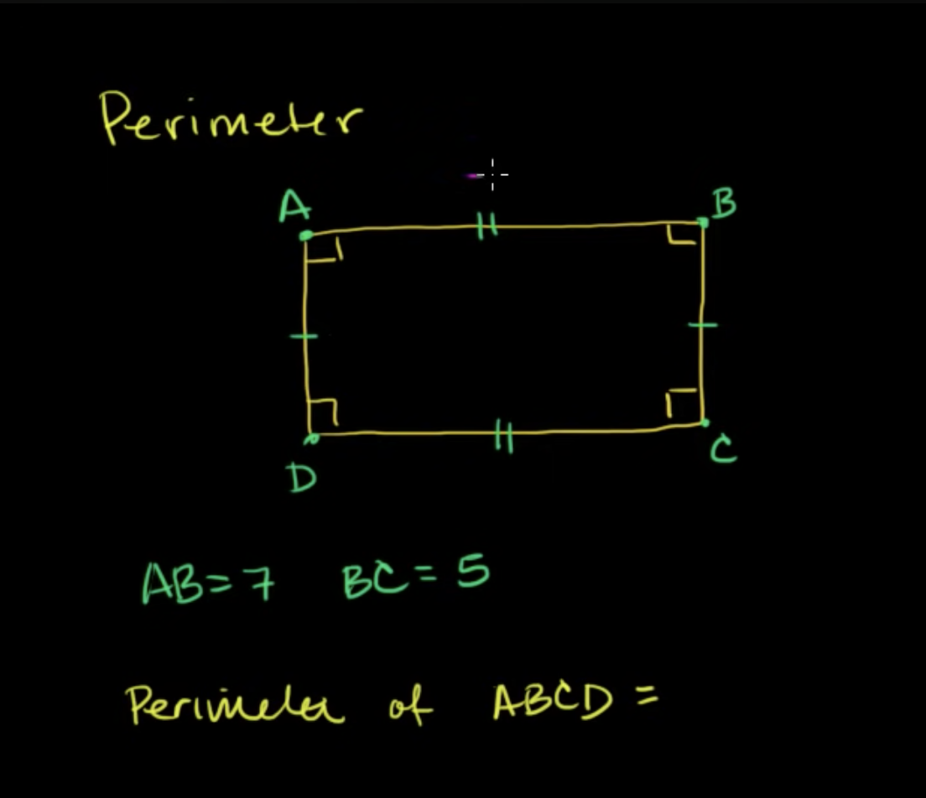
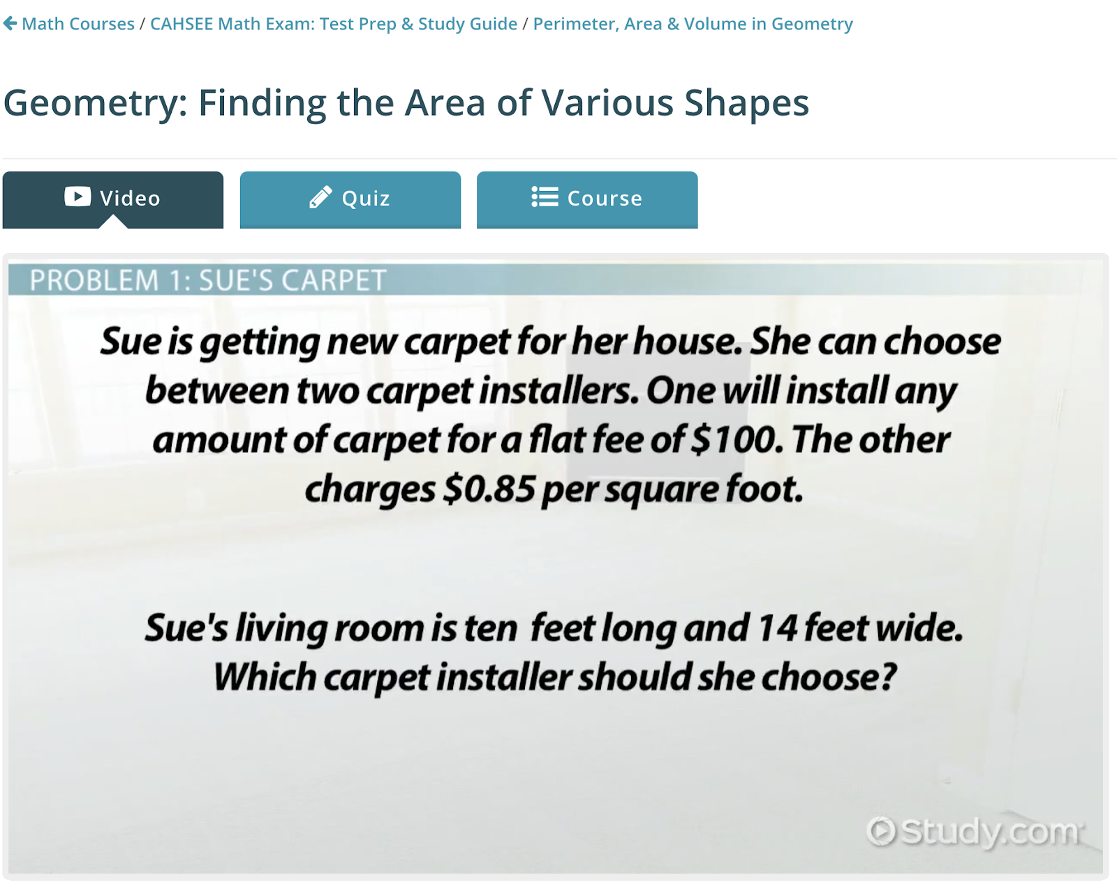
Findings context of questions are hard
‘question topic': 'perimeter',
'skill covered in question': 'finding the perimeter of a rectangle',
'complete question': 'What is the perimeter of ABCD?',
'complete question context': 'And we want to know, what is the perimeter of ABCD?',
'solution to complete question': 'The perimeter of rectangle ABCD is just going to be equal to the sum of the lengths of the sides.',
'start time of question': '1:12',
'end time of question': '2:07'
‘question topic': 'area of shapes',
'skill covered in question': 'area of rectangle',
'complete question': 'Which carpet installer should she choose?,
'complete question context': 'Sue is getting …. feet wide',
'solution to complete question': 'Sue should choose the flat fee installer, which would save her $19',
'start time of question': '1:12',
'end time of question': '2:07'

Slide 7
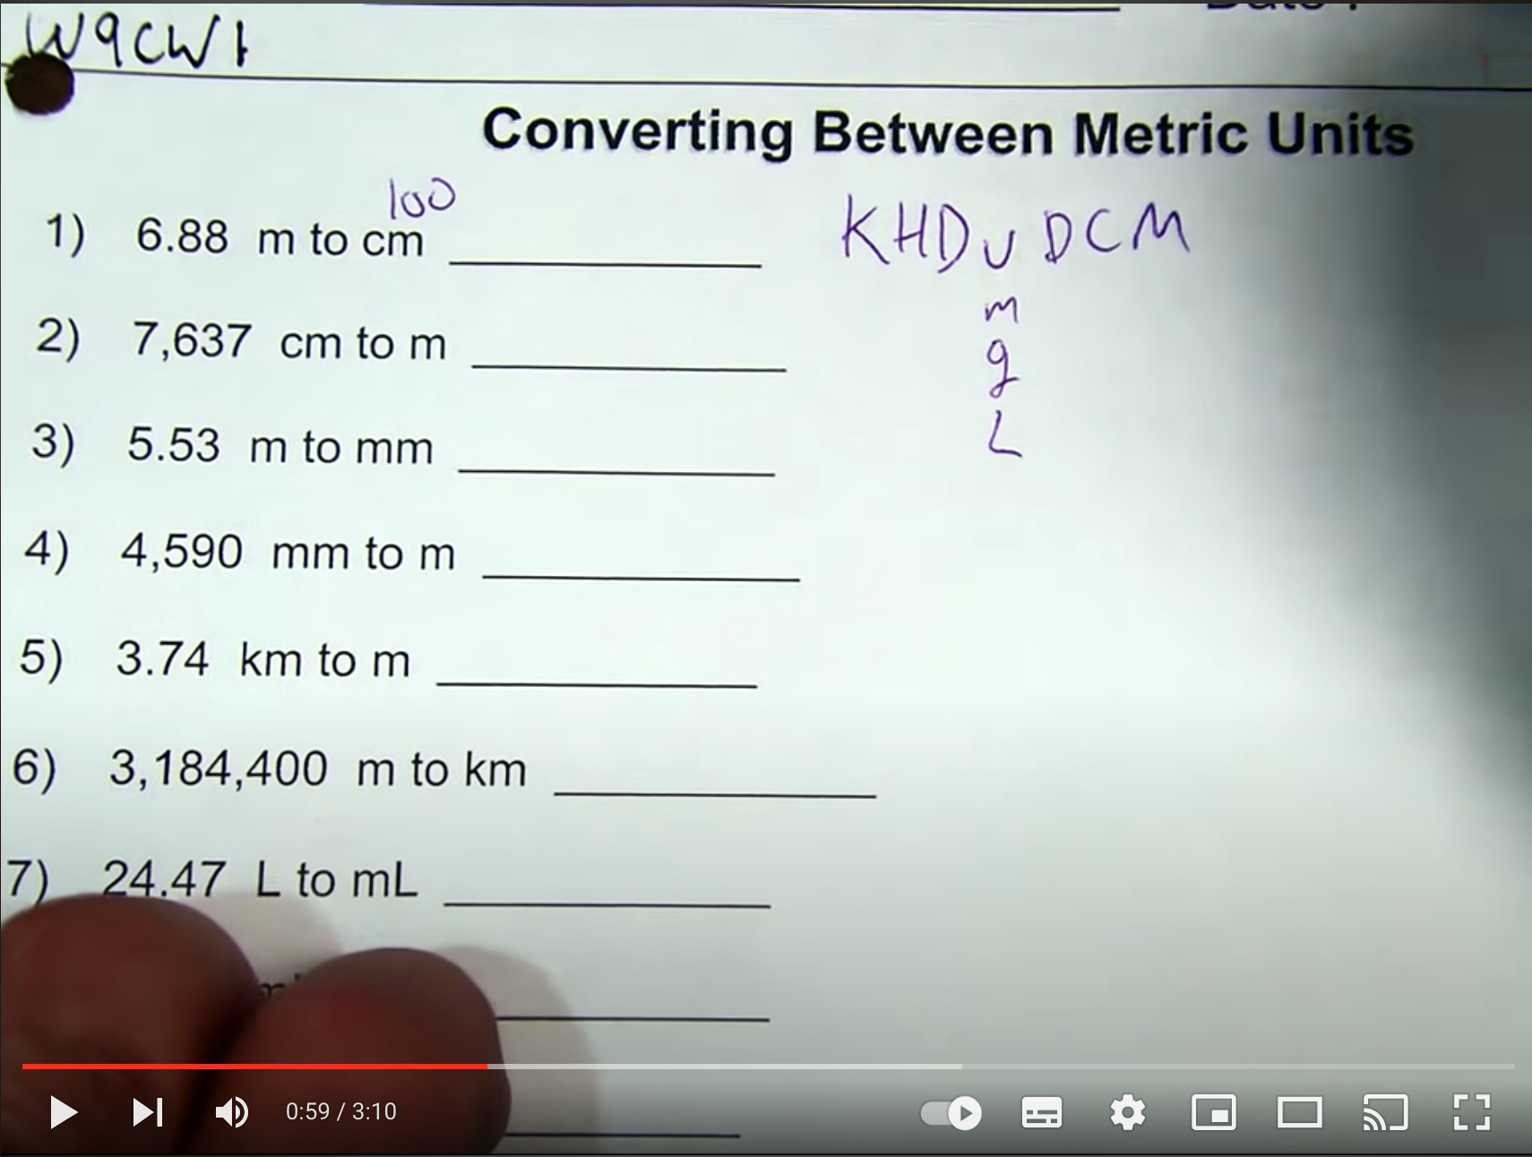
More Trouble with Context
LLM generated attributes:
question topic': 'converting between metric units',
'skill covered in question': 'converting from meters to centimeters', 'complete question': 'Convert 6.88 meters to centimeters.',
'complete question context': "entire video transcript",
'solution to complete question': '688 centimeters',
'start time of question': '0:00',
'end time of question': '3:06'

Slide 8
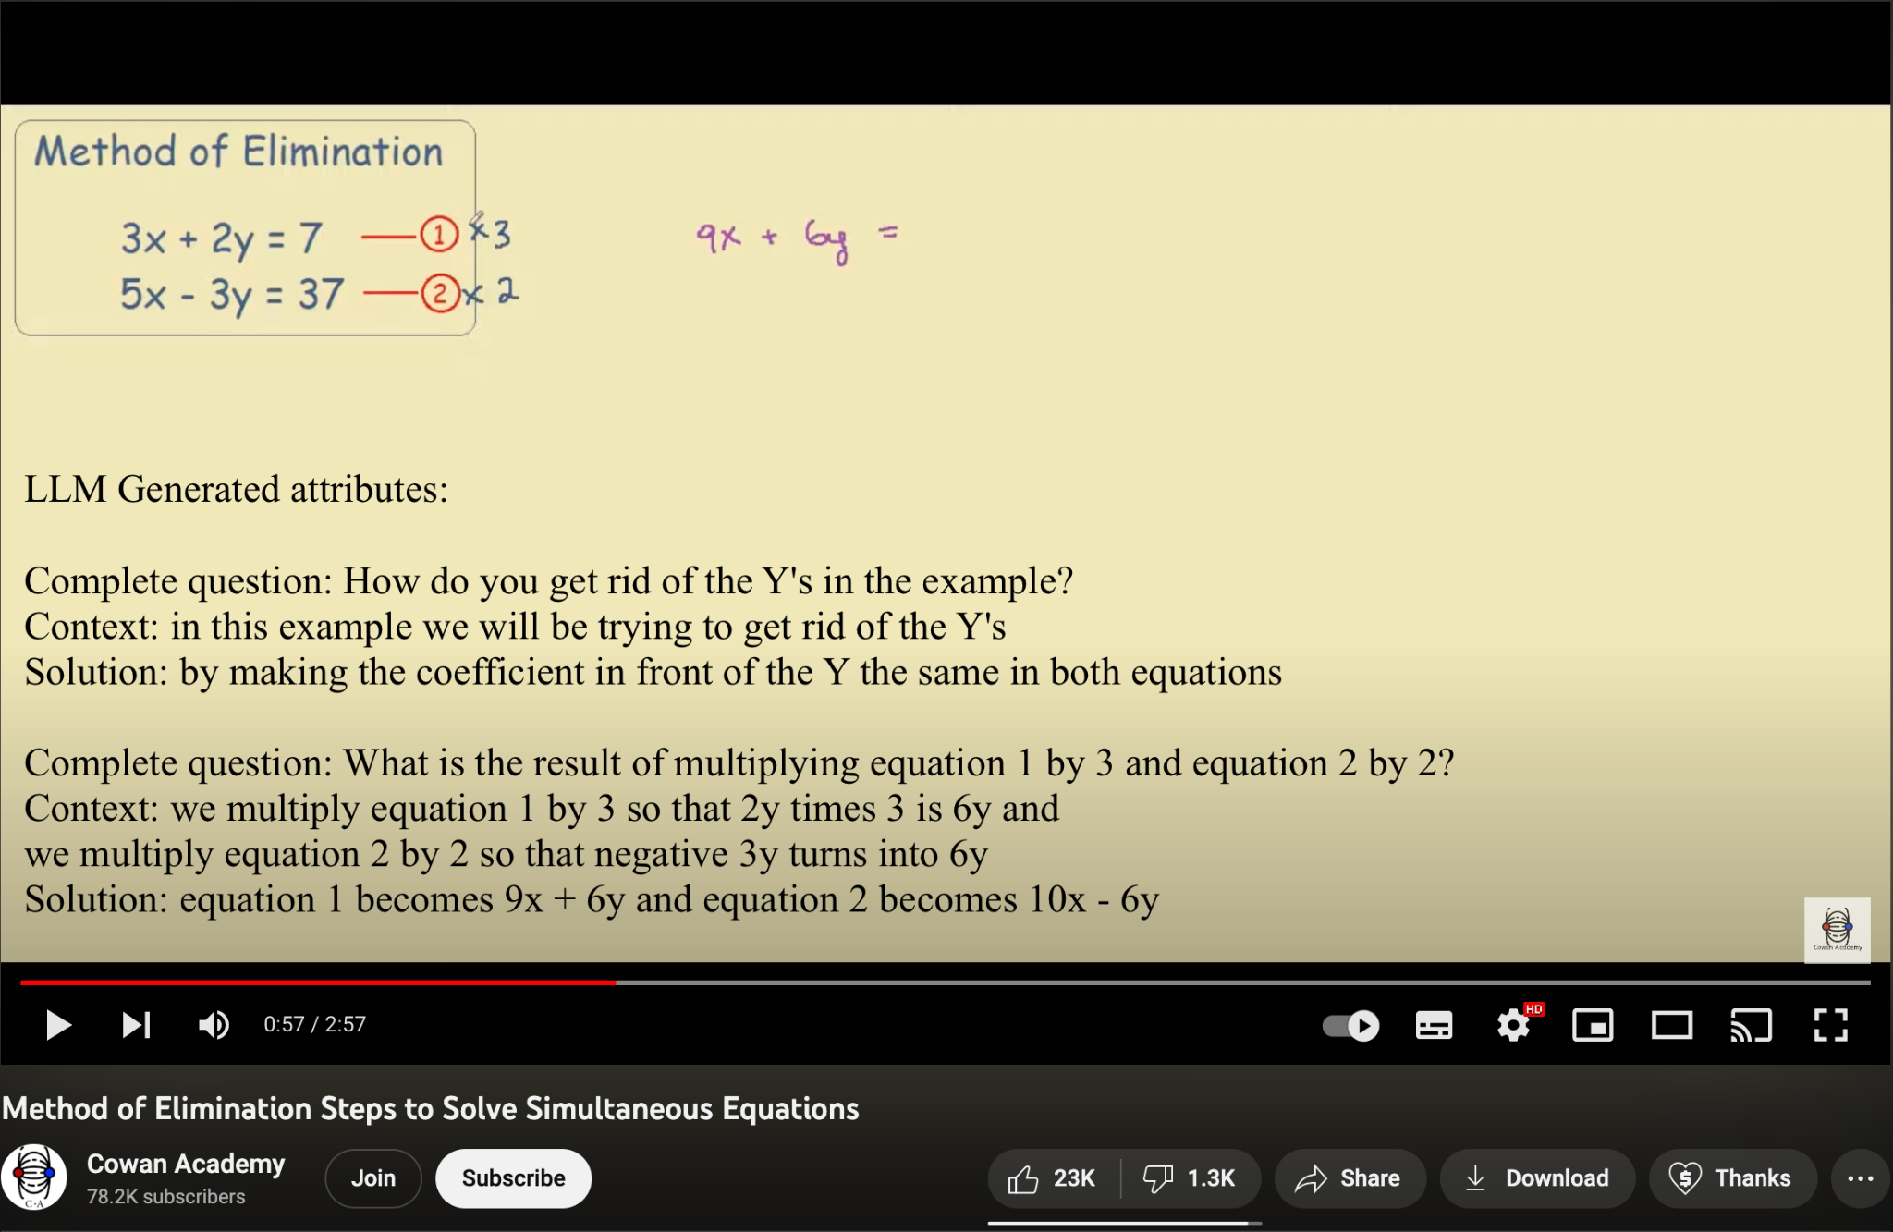
Impossible Context

Slide 9
Wrong solutions?
The sandwiches problem
1:06 right moby we want to know how many 1:08 slices of bread 1:09 are needed to make eight sandwiches
2:37 15 slices of bread
…….
2:51 we wanted to know how many slices of
2:53 bread we need to make 8 2:54 sandwiches i think we need 15 slices
3:00 you're right moby you should always
3:04 check your work hey i made a mistake in
3:07 my drawing
3:10 that's okay moby mistakes happen that's
3:13 why you need to check over your work
3:16 we need sixteen slices of bread
3:22 this loaf costs three dollars i'm paying
Wrong solution detected
Correct answer - missed

Slide 10
Missed questions? -multiple short questions in unit conversion
0:06 which I want to highlight on these 0:08 couple things on the homework tonight so 0:11 on the surface we have six point eight 0:13 eight meters to centimeters this seems 0:15 like a really intimidating thing yeah I 0:16 think oh there's a hundred centimeters 0:18 in a meter and we have to convert that 0:20 means you gotta go buds but it's a trick 0:23 there's no me in the mist Rodina show me 0:25 the science you just show me this it 0:27 goes 0:27 King Henry died sorry this a little bit 0:34 of noise and room 0:34 King Henry died unexpectedly drinking 0:42 chocolate milk sorry about that 0:45 King Henry died unexpectedly drinking 0:47 chocolate milk 0:48 this stands for kilometers hecta meters 0:51 decameters your unit which could be also 0:54 M G or L decimetres centimeters or 0:58 millimeters so we're converting from 1:01 millimeters I'm sorry 1:02 we're converting from meters to 1:04 centimeters trying to count how many 1:06 spaces I'm gonna move over I go I'm 1:09 going one two spaces from my m to my C 1:15 in this case I move over to two spaces 1:17 to the right as well going one two 1:20 spaces to the right so my final answer 1:24 will be 688 centimeters find next time 1:29 do it in black pen for next one I'm 1:31 going let's do number three me there's 1:34 two millimeters I'm going from my unit 1:36 my m2 my millimeter going one two three 1:40 spaces to the right so I'm going to go 1:42 one two three spaces to the right now I 1:45 ran out of space so I have to add a 1:47 placeholder zero 5530 millimeters now
Question detected
Solution detected
Question not detected

Slide 11
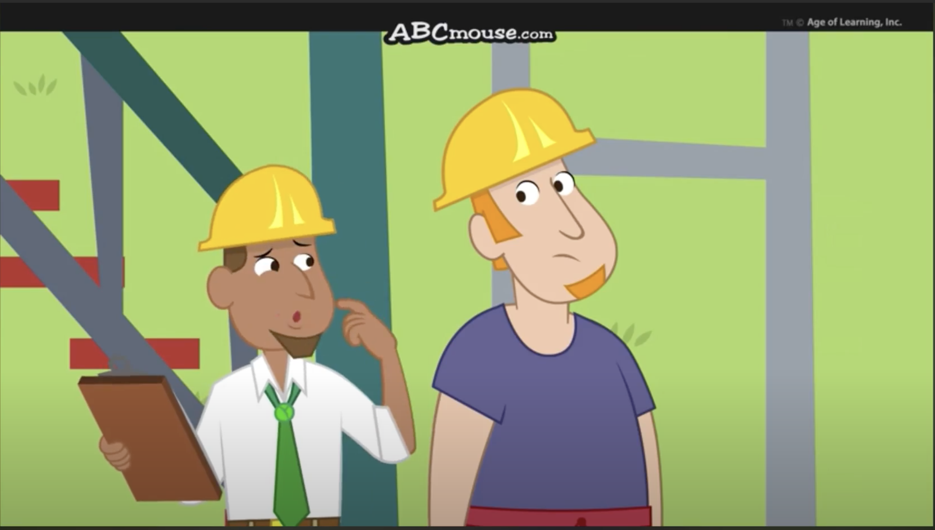
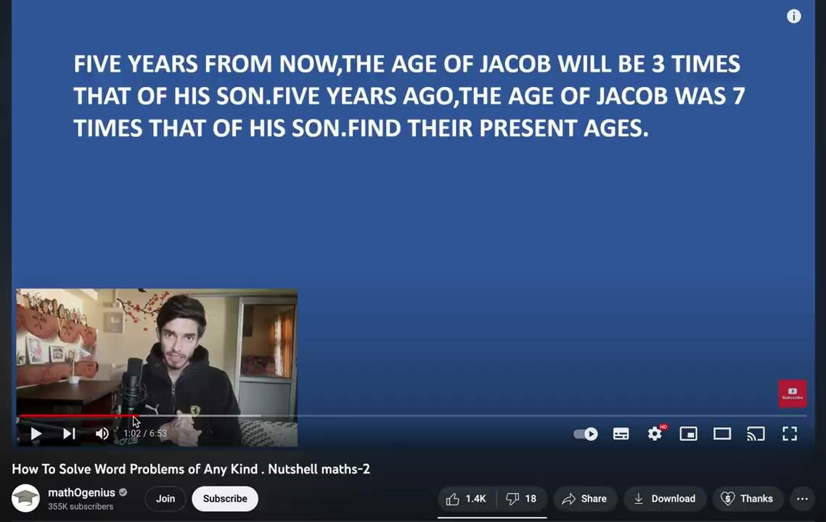
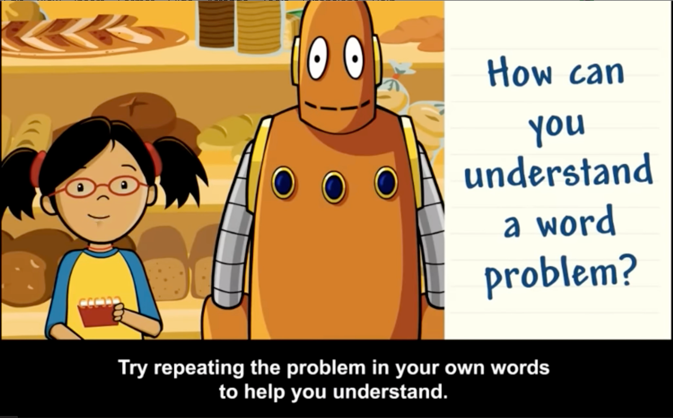
Entertainment or Pause for Reflection?
Presenter Paused for viewers reflection and NO entertaining off topic contents present
Presenter Paused for viewers reflection and video has entertaining off topic contents

